Slide 1
SPH-Simulation
2019-2 Interactive Visualization Term Project
2016320189 이광렬

Slide 2
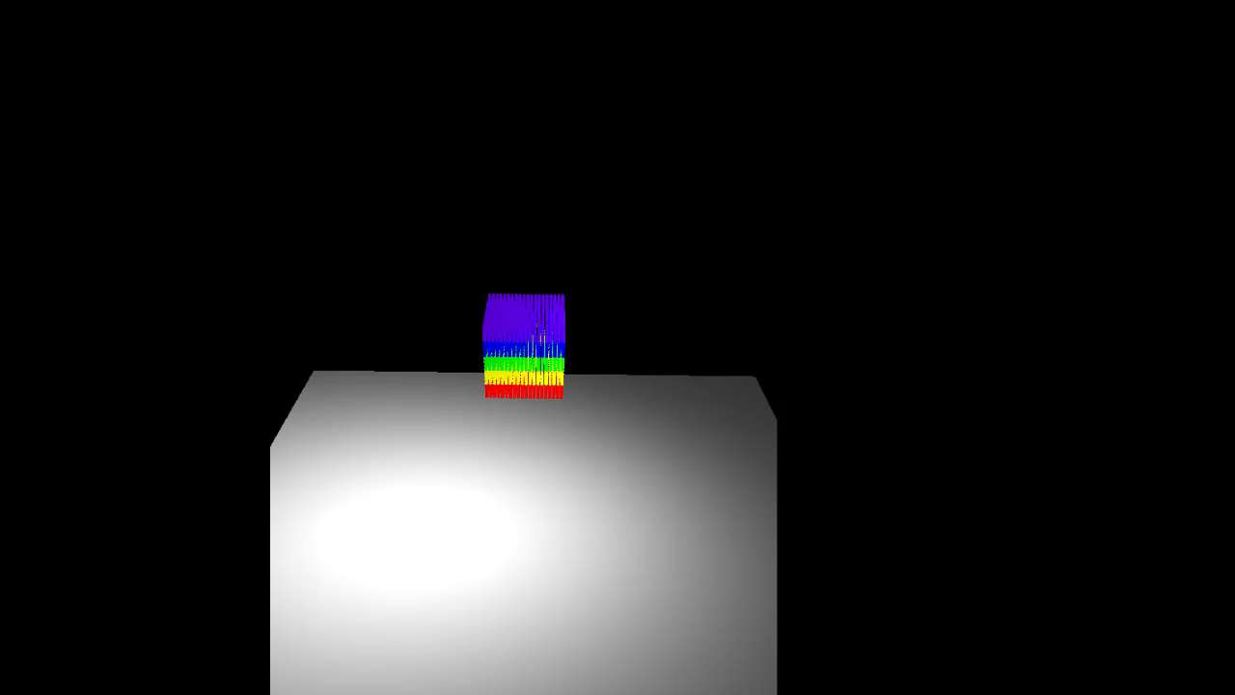
Term Project Demo Video

Slide 3
구현 사항
기본 구현 사항
추가 구현 사항
3D SPH
Particles
Force, Density
Integrate
Lighting
Background Texture
Advanced Data Structure

Slide 4
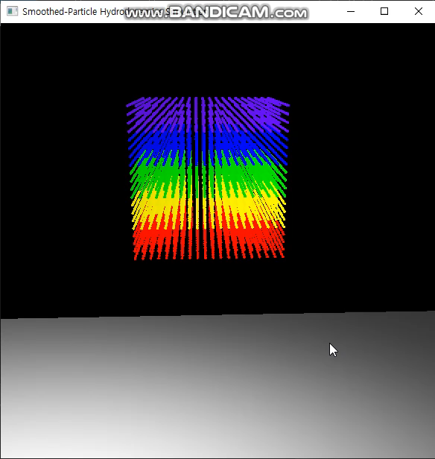
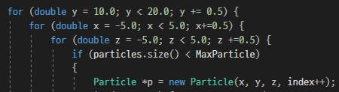
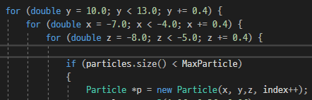
Particles
damBreaking()
Pouring()

Slide 5
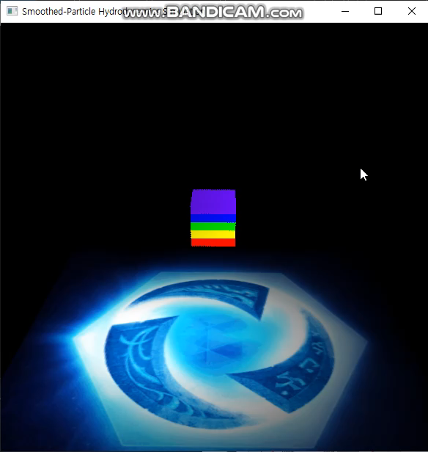
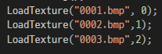
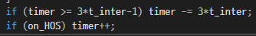

Texture

